Slide 1
Sweetwater Union HS district Sexual Health Education
MiDDLe School

Slide 2
California Healthy Youth Act
As of January 1, 2016, students in CA must receive sexual health education that is…
Comprehensive,
Unbiased,
Medically accurate,
Age-appropriate
At least once in middle and high schools.

Slide 3
California Healthy Youth Act
Topics to be covered include:
Value of delaying sexual activity
All FDA-approved methods of preventing pregnancy and HIV/STDs
PrEP and PEP
Knowledge and skills to form healthy relationships
All three pregnancy options
Sexual harassment, sexual assault, adolescent relationship abuse and sex trafficking
Affirmative recognition of different sexual orientations
Gender, gender expression, gender identify and harm of negative gender stereotypes
Local resources and laws

Slide 4
Minor Consent laws

Slide 5
Minor Consent Laws
California law allows minors under the age of 18 to obtain certain services without parent’s consent.
Minors of any age may receive services related to:
Pregnancy and pregnancy related care & prevention
Family planning services
Sexual assault services

Slide 6
Minor Consent Laws
In addition, if they are over 12 years of age they are able to receive:
Sexually transmitted diseases treatment and prevention
HPV vaccination and PrEP
Certain drug and alcohol abuse treatment/counseling
Mental health outpatient care

Slide 7
Minor Consent Laws
California law allows minors in grades 7-12 to leave campus during school hours if they need any confidential health services.
By law parents cannot be notified of this absence.
School shall not be held liable.
Minors who would like to receive these services should go to the closest clinic and ask for minor consent services. The California Family PACT Program and/or Medi-Cal may cover some or all of these confidential minor consent services.

Slide 8
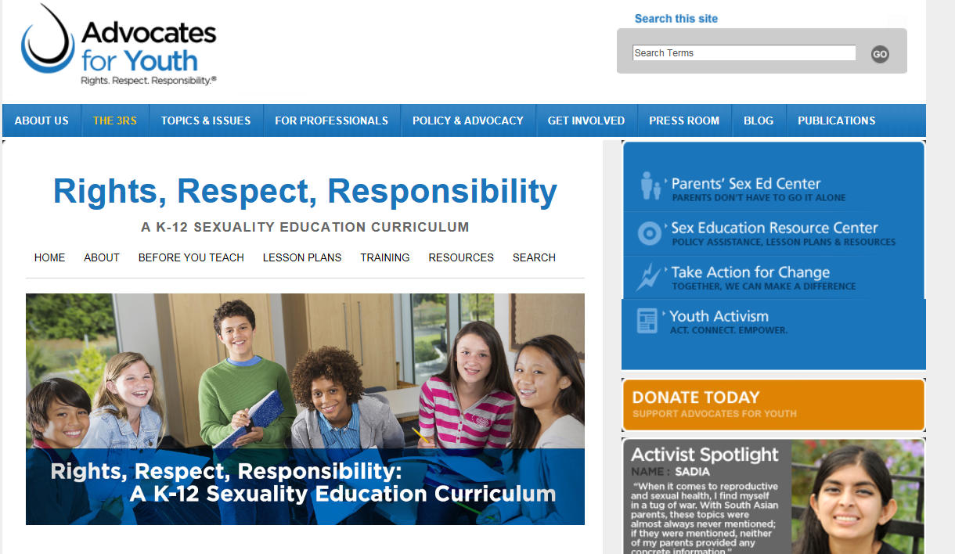
Curriculum & Lesson Plans

Slide 9
Lesson 7.3
Reproduction Basics: Fertility & Menstrual Cycle
Describe the process of human reproduction by identifying the correct order of the steps involved with conception.
Define sexual intercourse.

Slide 10
Lesson 7.5
Protecting Your Health: Understanding and Preventing STDs
Define STDs and HIV.
Name at least three common STDs and how they are transmitted.
Compare sexual behaviors that put people at high, low or no risk for STDs.

Slide 11
Lesson 7.6
I Am Who I Am: Understanding Gender Identity & Sexual Orientation
Define the terms sexual orientation, gender identity and gender expression.
Describe how each term is different from the others.
Name at least two factual statements and two incorrect statements about sexual orientation and gender.
List at least two respectful ways of communicating with or about LGBTQ individuals.

Slide 12
Lesson 7.9
Let’s Talk About Sex
Describe three different types of communication people use.
Demonstrate how to effectively use assertive communication in relationships.

Slide 13
Lesson 7.10
Being The Change You Want To See In The World
Describe their own experiences of being disrespected and the impact these experiences had on them.
List at least two examples of ways in which people are treated respectfully or disrespectfully because of their gender and/or sexual orientation.
Describe at least one situation in which a young person was discriminated against because of their gender or sexual orientation, and the steps they took to advocate for change that would end that discrimination.

Slide 14
Lesson 7.11
Being Smart, Staying Safe Online
Describe positive aspects of online talking and messaging.
Identify examples of flirting and chatting that can be inappropriate or risky.
Demonstrate an understanding of how to deal with uncomfortable situations when communicating online.

Slide 15
Lesson 8.7
Warning Signs: Understanding Sexual Abuse and Assault
Name at least two different types of sexual assault.
List at least one example of each of the following: mutual consent, unfair manipulation, threats and aggression.
Describe at least two possible impacts of a sexual assault or abusive relationship on the person who was assaulted.
Demonstrate an understanding of how to report a sexual assault or abusive relationship.

Slide 16
Lesson 8.8
Birth Control Basics
Describe the impact of correct and consistent use of a birth control method on how effective it is at preventing pregnancy.
Correctly recall that there is generally a gap between when a person may start to have vaginal sex and when they may wish to get pregnant, which makes using effective birth control important.
State correctly what emergency contraception is.

Slide 17
Lesson 8.9
Using Condoms Effectively
Condom demonstration
Describe correctly, and in order, the steps to using an external condom.
Describe how an internal condom is used.

Slide 18
Gender and Sexual Orientation

Slide 19
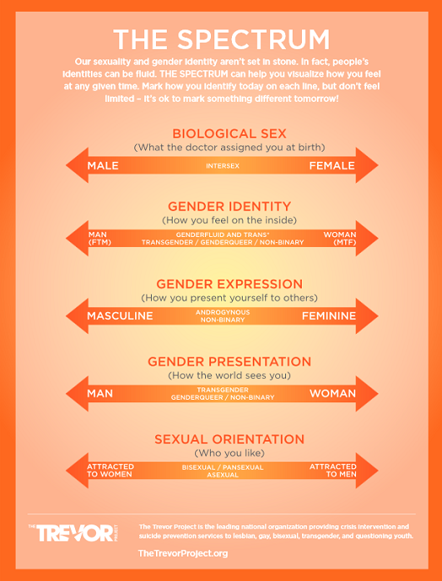

Slide 20
What does LGBTQQ stand for?
Lesbian
Gay
Bisexual
Transgender
Questioning
Queer (a general term for someone who doesn't confine to the gender binary)

Slide 21
Pronouns
Her, She, Hers
He, His, Him
Them, they, they’re
WHEN IN DOUBT JUST ASK!

Slide 23
Consent
Consent is when someone agrees, gives permission, or says yes enthusiastically to sexual activity with someone else.
Asking for consent works by checking in with the other person about the sexual activity a person is interested in doing.
For any sexual activity to happen, both people need to consent, or say yes, willingly and freely.
Sexual activity does not just mean sex, it includes kissing, hugging, making out, cuddling, and touching someone’s body in a sexual way.

Slide 24
Tea as consent
Tea as Consent

Slide 25
Coercion
Coercion is when someone pressures the other person to turn their “no” into a “yes”.
Make you feel like you owe them — ex. Because you’re in a relationship, because you’ve had sex before, because they spent money on you or bought you a gift, because you go home with them
Give you compliments that sound extreme or insincere as an attempt to get you to agree to something
Badger you, yell at you or hold you down
Give you drugs and alcohol to loosen up your inhibitions
Can also include getting someone drunk or high in order to have sex with them.
Getting someone’s consent when they are not sober isn’t truly consent.

Slide 26
“Yes means Yes”
Law signed by Governor Jerry Brown in 2014
California has become the first U.S. state to define when "yes means yes" in sexual assault cases and provides a clear definition of when people agree to sex.
"Lack of protest or resistance does not mean consent," the law states, "nor does silence mean consent.

Slide 27
Resources
Loveisrespect.org
www.thatsnotcool.com
http://teenhealthsource.com/sex/sconsent/
http://teentalk.ca/hot-topics/consent-2/

Slide 28
Sex Trafficking

Slide 29
Human Trafficking
What is Human Trafficking?
Sex Trafficking
Who is being trafficked?
Almost every demographic (most vulnerable = young girls, transient youth, foster youth, LGBTQ youth, homeless population)
How are they recruited?
Romeo/“boyfriend” recruits young girl a few months into the relationship
Gangs
Online (social media)
Clubs or Bars
Schools
Notes:
Human Trafficking- the ACT (or what is physically being done) the MEANS by which the act is occurring,
and the PURPOSE behind these actions.
Sex Trafficking: Occurs when someone uses force, fraud, or coercion to cause a commercial sex act with an adult or causes a minor to commit a commercial sex act

Slide 30
Human Trafficking
Where is this happening?
Major port cities all around the world
In the US
Texas, California and New York
CA one of the worst offenders
San Francisco, Los Angeles, San Diego
Multiple entries and exits out of the cities
Easy to hide

Slide 31
Human Trafficking
When to get help and how to ID someone?
Much older boyfriend or girlfriend (or friends)
Lack of ID
Often seen at the ER multiple times for similar aliment
Physical abuse
Signs of branding or tattoos
Unusually fearful and submissive
Chronic depression and exhaustion
Hostile, hyper-vigilant or anxious demeanor
Not in school at all or very little
Notes:
There are a number of signs that can help us identify victims of human trafficking or sexual exploitation
(usually the indicators are similar for both human trafficking AND sexual exploitation)
Some general indicators may be when victims are
1) accompanied to the clinic by another person who seems controlling,
2) the accompanying person insists on providing health information
3) patient lacks identification documentation or it is in the possession of an accompanying individual
Some physical indicators include
physical abuse (bruises, fractures, trauma), 2) signs of branding or tattoos,
3) conditions that could easily be addressed with routine medical care (i.e. sexual diseases, advanced respiratory infections)
4) physical aspect where it is evident that the patient is in an unsanitary environment 5)substance abuse
Some Psychological Indicators include
1) unusually fearful, submissive, 2) The patient exhibits signs of exhaustion or depression,
3) hostile, hyper-vigilant, or anxious demeanor

Slide 32
Human Trafficking
How to get help? Polaris
Call or text
1 (888) 373-7888
SMS: 233733 (Text "HELP" or "INFO")
Hours: 24 hours, 7 days a week
Languages: English, Spanish and 200 more languages
Website: traffickingresourcecenter.org
Minor call Child Protective Services

Slide 33
HIV

Slide 34
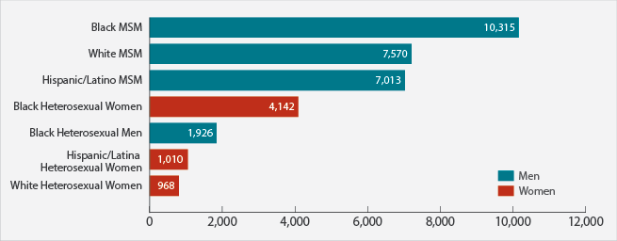
HIV and societal perceptions
New HIV Diagnoses in the United States for the Most-Affected Subpopulations, 2015
Source: https://www.cdc.gov/hiv/statistics/overview/ataglance.html

Slide 35
HIV and societal perceptions
HIV (Human Immunodeficiency Virus)
Blood, Semen, Pre-ejaculate, breast milk, vaginal fluid, anal fluid
History
1981 CDC believes this marks the beginning of the AIDS epidemic
Believed to be a disease that only affected gay men
1985 First time the epidemic mentioned publically by the president
Patient Zero myth
Notes:
Patient O (out of California) was interpreted as patient 0 (zero)
Patient O did not bring HIV into the US! There were cases as early as the 1970s in NY (probably came over to the US via Haiti)

Slide 36
HIV and societal perceptions
Source: SanDiegoCounty.gov

Slide 37
Where SYHC fits in…

Slide 38
Where SYHC fits in…
Presentations by trained Health Educators
Programs to support the youth at school sites
Curriculum Support
Resources
Teen Clinic Services

Slide 39
Presentations
The Reproductive System: Anatomy and Physiology
Family Planning: Contraceptive Methods
Sexually Transmitted Infections (STIs) including HIV
Healthy Relationships and Harassment, including bullying
Sexual Assault
Substance Abuse
Stress management
Nutrition and Fitness
Sexual Orientation and Gender Identity

Slide 40
Questions
Tara Beeston, MPH
STD Prevention Program Manager
County of San Diego, Health and Human Services Agency
Tara.Beeston@sdcounty.ca.gov, 619 293 4744
Jessica Chapman, MA
Program Supervisor
Jessica.Chapman@syhc.org
Phone: (619) 662-4100 ext. 2906
Ilana Brongiel, MPH
Program Manager
igoldberg@syhc.org
Phone: (619) 205-6347

